Slide 1
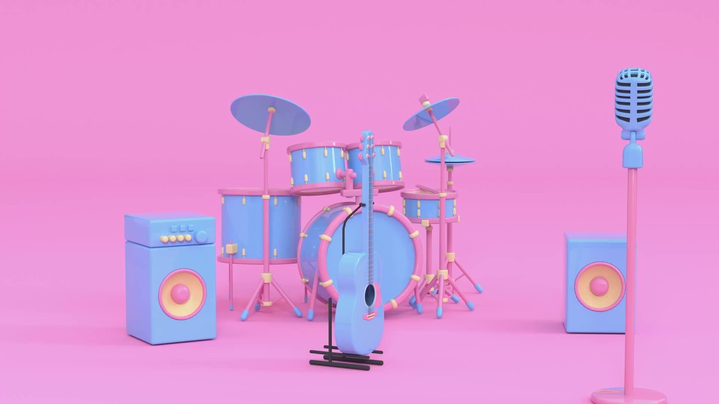
Music Store
Presented By:
Uday Kumar

Slide 2
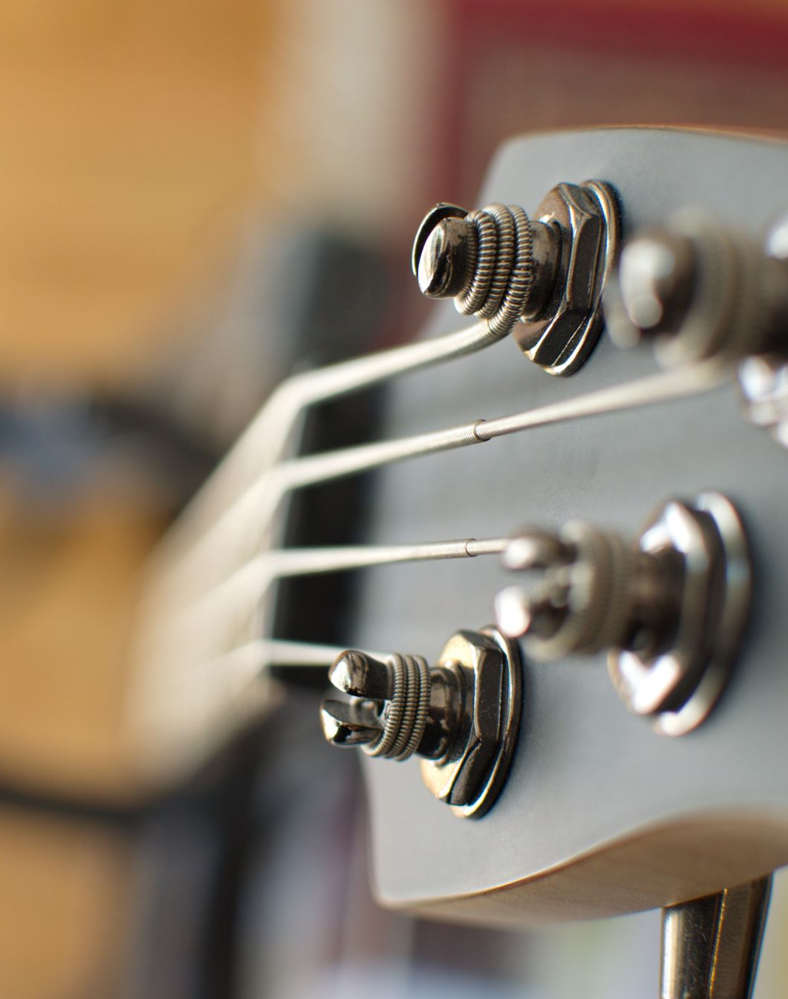
Abstract
RMusic is an online music store that offers a diverse range of musical instruments, categorized into strings, winds, percussion, and electronic instruments. The website provides a user-friendly interface, allowing visitors to explore, purchase, and engage with the world of music. With responsive design and dynamic functionality, RMusic aims to create a seamless and enjoyable online shopping experience for music enthusiasts.

Slide 3
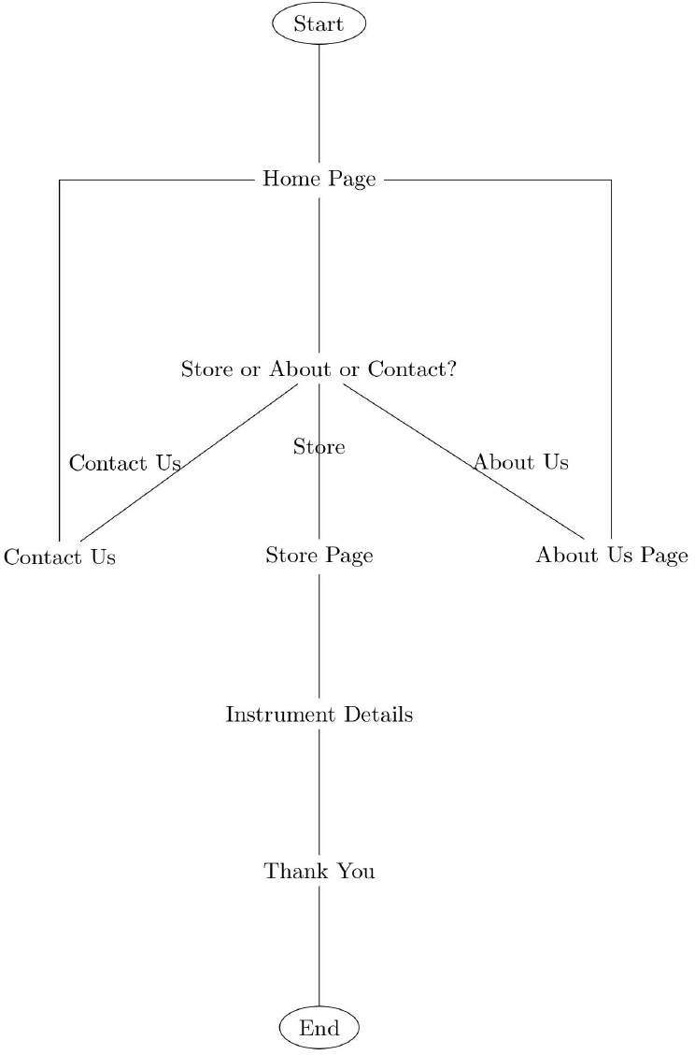
Flow Chart

Slide 4

Tech Stack Used
HTML (HyperText Markup Language):
Used for structuring the content and creating the basic layout of the web pages.
CSS (Cascading Style Sheets):
Responsible for styling and formatting the visual presentation of the website, including fonts, colors, and layout.
JavaScript:
Utilized for implementing dynamic functionality on the website, such as switching between different sections, expressing gratitude on instrument purchase, and controlling the overall flow of the site.

Slide 5
About the Website
Home Page:
Welcome message and quote about music.
"Visit Store" button for online shopping.
Online Store
Categories: String, Wind, Percussion, Electronic Instruments.
Instruments displayed with images, names, prices, and "Buy Now" buttons.
Instrument Details:
"Buy Now" triggers a function expressing gratitude.
Users directed to a "Thank You" section, encouraging return visits.

Slide 6
Navigation:
Menu bar for Home, About, and Contact sections.
Responsive design for a consistent user experience.
Other Sections:
"About" section details RMusic's mission, values, and community engagement.
"Contact" section provides essential information for inquiries.
Return to Home:
Option to return to the Home page using the menu or a dedicated button.
Responsive Design:
Ensures consistent and enjoyable experience on various devices.

Slide 7
Home Page
<!DOCTYPE html>
<html lang="en">
<head>
<meta charset="UTF-8">
<meta name="viewport" content="width=device-width, initial-scale=1.0">
<title>R-Music</title>
<link rel="stylesheet" href="Start.css">
</head>
<body>
<div class="menubar">
<div class="log">
<h1>&nbsp;&nbsp;RMusic</h1>
</div>
<div class="tit">
<div>
<h3 onclick="hom()">Home</h3>
</div>
<div>
<h3 onclick="about()">About</h3>
</div>
<div>
<h3 onclick="conta()">Contact</h3>
</div>
</div>
</div>
<div class="tot">
<div class="ord">
<div class="hea">
<h3>Welcome to RMusic</h3>
</div>
<div class="det">
<p>Beautiful music is the art of the prophets that can calm the agitations of the soul;<br> It is one of
the most magnificent and delightful presents God has given us. <br>- <strong>Martin Luther</strong>
</p>
</div>
<div class="buto">
<button onclick="ord()">Visit Store</button>
</div>
</div>
</div></body>

Slide 8
Store Page
<div class="orde">
<div class="menu">
<div class="head">
<h2>String Instruments</h2>
</div>
<div class="items">
<div class="box">
<img src="Guitar.webp" alt="">
<h2>Guitar</h2>
<p>Rs.30,000</p>
<button onclick="thank()">Buy Now</button>
</div>
<div class="box">
<img src="violin.webp" alt="">
<h2>Violin</h2>
<p>Rs.25,000</p>
<button onclick="thank()">Buy Now</button>
</div>
<div class="box">
<img src="banjo.webp" alt="">
<h2>Banjo</h2>
<p>Rs.15,000</p>
<button onclick="thank()">Buy Now</button>
</div>
<div class="box">
<img src="harp.webp" alt="">
<h2>Harp</h2>
<p>Rs.40,000</p>
<button onclick="thank()">Buy Now</button>
</div>
<div class="box">
<img src="mandolin.webp" alt="">
<h2>Mandolin</h2>
<p>Rs.18,000</p>
<button onclick="thank()">Buy Now</button>
</div>
</div>
</div>
<div class="menu">
<div class="head">
<h2>Wind Instruments</h2>
</div>
<div class="items">
<div class="box">
<img src="flute.webp" alt="">
<h2>Flute</h2>
<p>Rs.8,000</p>
<button onclick="thank()">Buy Now</button>
</div>
<div class="box">
<img src="saxophone.webp" alt="">
<h2>Saxophone</h2>
<p>Rs.35,000</p>
<button onclick="thank()">Buy Now</button>
</div>
<div class="box">
<img src="clarinet.webp" alt="">
<h2>Clarinet</h2>
<p>Rs.22,000</p>
<button onclick="thank()">Buy Now</button>
</div>
<div class="box">
<img src="trumpet.webp" alt="">
<h2>Trumpet</h2>
<p>Rs.28,000</p>
<button onclick="thank()">Buy Now</button>
</div>
<div class="box">
<img src="trombone.webp" alt="">
<h2>Trombone</h2>
<p>Rs.30,000</p>
<button onclick="thank()">Buy Now</button>
</div>
</div>
</div>
<div class="menu">
<div class="head">
<h2>Percussion Instruments</h2>
</div>
<div class="items">
<div class="box">
<img src="drums.webp" alt="">
<h2>Drums</h2>
<p>Rs.50,000</p>
<button onclick="thank()">Buy Now</button>
</div>
<div class="box">
<img src="bongo.webp" alt="">
<h2>Bongo</h2>
<p>Rs.12,000</p>
<button onclick="thank()">Buy Now</button>
</div>
<div class="box">
<img src="conga.webp" alt="">
<h2>Conga</h2>
<p>Rs.15,000</p>
<button onclick="thank()">Buy Now</button>
</div>
<div class="box">
<img src="marimba.webp" alt="">
<h2>Marimba</h2>
<p>Rs.45,000</p>
<button onclick="thank()">Buy Now</button>
</div>
<div class="box">
<img src="xylophone.webp" alt="">
<h2>Xylophone</h2>
<p>Rs.20,000</p>
<button onclick="thank()">Buy Now</button>
</div>
</div>
</div>
<div class="menu">
<div class="head">
<h2>Electronic Instruments</h2>
</div>
<div class="items">
<div class="box">
<img src="keyboard.webp" alt="">
<h2>Keyboard</h2>
<p>Rs.25,000</p>
<button onclick="thank()">Buy Now</button>
</div>
<div class="box">
<img src="synthesizer.webp" alt="">
<h2>Synthesizer</h2>
<p>Rs.40,000</p>
<button onclick="thank()">Buy Now</button>
</div>
<div class="box">
<img src="electricguitar.webp" alt="">
<h2>Electric Guitar</h2>
<p>Rs.32,000</p>
<button onclick="thank()">Buy Now</button>
</div>
<div class="box">
<img src="drummachine.webp" alt="">
<h2>Drum Machine</h2>
<p>Rs.18,000</p>
<button onclick="thank()">Buy Now</button>
</div>
<div class="box">
<img src="midicontroller.webp" alt="">
<h2>MIDI Controller</h2>
<p>Rs.15,000</p>
<button onclick="thank()">Buy Now</button>
</div>
</div>
</div>
</div>

Slide 9
Thank You Page
<div class="tha">
<div class="ord">
<div class="hea">
<h3>Thank You For Shopping at RMusic</h3>
</div>
<div class="det">
<p>Hope you to have a wonderful melodious day ahead.<br>Please Visit Again</p>
</div>
<div class="buto">
<button onclick="hom()">Go to Home</button>
</div>
</div>
</div>

Slide 10
About Us Page
<div class="abo">
<div class="hea">
<h1>About Us</h1><br><br>
<h2>Our Melodic Journey</h2><br>
<p>Embarking on a musical odyssey, RMusic was born in 2024 with a mission to redefine the way you
experience music. Our commitment is to offer a diverse range of musical instruments that resonate with
both contemporary and traditional vibes, ensuring a harmonious adventure for every musician.</p><br>
<h2>Celebrating Musical Mastery</h2><br>
<p>At RMusic, our space is a haven of creativity, where skilled artisans and music enthusiasts come
together to curate instruments that not only sound exquisite but also inspire musical excellence. We
take
pride in our collection, blending global influences with timeless craftsmanship.</p><br>
<h2>Sourcing Harmony Locally</h2><br>
<p>Committed to quality, we source our materials locally to ensure each instrument produces the highest
caliber
of sound. By supporting local craftsmen and artists, we not only guarantee top-notch musical experiences
but also contribute to the richness of our artistic community.</p><br>
<h2>Harmonious Hospitality</h2><br>
<p>Beyond our beautiful instruments, RMusic is defined by warm hospitality. Our knowledgeable and
passionate staff is here to make your musical journey exceptional, ensuring every visit is filled with
warmth, comfort, and genuine care.</p><br>
<h2>Community of Crescendos</h2><br>
<p>As a proud member of the music community, RMusic actively engages in initiatives that promote
musical education and well-being. We believe in fostering the love for music and are dedicated to making
a positive impact through various music programs and events.</p><br>
<h2>Play On with Us</h2><br>
<p>Whether you're a beginner or a seasoned musician, RMusic invites you to explore our world of musical
delight. Find the perfect instrument, embark on a melodious journey, and let RMusic be the
soundtrack to your musical dreams.</p><br>
<h4>Thank you for choosing RMusic. Established in 2024, we are excited to be part of your musical
journey, and we look forward to harmonizing with you with passion and excellence.</h4>
</div>
</div>

Slide 11
Contact Page
<div class="con">
<div class="hea">
<h1>Contact Us</h1><br>
<p>For any inquiries, please contact us using the information below:</p><br>
<p><strong>Founder:</strong> RMusic</p><br>
<p><strong>Address:</strong> Marathahalli, Bangalore-560067</p><br>
<p><strong>Contact Number:</strong> 9876543210</p><br>
<p><strong>Email:</strong> <a href="mailto:RMusic@gmail.com">RMusic@gmail.com</a></p>
</div>
</div>

Slide 12
CSS
* {
margin: 0;
padding: 0;
box-sizing: border-box;
} body {
background-image: linear-gradient(to bottom, rgba(0, 0, 0, 0.5), rgba(0, 0, 0, 0.5)), url(store.webp);
background-size: cover;
display: flex;
flex-direction: column;
} .menubar {
width: 100%;
display: flex;
justify-content: space-between;
background-color: antiquewhite;
border-radius: 7px;
opacity: 0.7;
} .log h1 {
padding: 15px;
} .tit {
display: flex;
padding: 10px;
}
.tit div {
padding: 15px;
} .tit h3 {
cursor: pointer;
} .tot{
width: 100%;
height: 70vh;
display: flex;
align-items: center;
justify-content: center;
opacity: 0.9;
} .ord {
padding: 30px;
border-radius: 5px;
display: flex;
flex-direction: column;
box-shadow: rgba(6, 24, 44, 0.4) 0px 0px 0px 2px, rgba(6, 24, 44, 0.65) 0px 4px 6px -1px, rgba(255, 255, 255, 0.08) 0px 1px 0px inset;
background-color: antiquewhite;
opacity: 0.7;
} .hea {
padding: 15px;
align-self: center;
} .buto {
padding: 15px;
align-self: center;
} .det {
padding: 15px;
flex-direction: column;
} button {
background-color: blanchedalmond;
width: 100px;
height: 50px;
cursor: pointer;
} .orde {
display: none;
padding: 15px;
flex-direction: column;
} .abo,
.con {
align-items: center;
border-radius: 5px;
box-shadow: rgba(50, 50, 93, 0.25) 0px 50px 100px -20px, rgba(0, 0, 0, 0.3) 0px 30px 60px -30px, rgba(10, 37, 64, 0.35) 0px -2px 6px 0px inset;
background-color: antiquewhite;
display: none;
padding: 15px;
margin: 15px;
opacity: 0.8;
} .abo,
.con p {
margin-left: 30px;
} .menu {
display: flex;
flex-direction: column;
padding: 20px;
margin: 20px;
box-shadow: rgba(0, 0, 0, 0.25) 0px 54px 55px, rgba(0, 0, 0, 0.12) 0px -12px 30px, rgba(0, 0, 0, 0.12) 0px 4px 6px, rgba(0, 0, 0, 0.17) 0px 12px 13px, rgba(0, 0, 0, 0.09) 0px -3px 5px;
background-color: antiquewhite;
border-radius: 7px;
opacity: 0.8;
} .items {
padding: 20px;
display: flex;
justify-content: space-evenly;
} .box {
border-radius: 10px;
width: fit-content;
display: flex;
box-sizing: border-box;
align-items: center;
justify-content: center;
text-align: center;
flex-direction: column;
padding: 30px;
margin: 30px;
background-color: aliceblue;
box-shadow: rgba(0, 0, 0, 0.25) 0px 54px 55px, rgba(0, 0, 0, 0.12) 0px -12px 30px, rgba(0, 0, 0, 0.12) 0px 4px 6px, rgba(0, 0, 0, 0.17) 0px 12px 13px, rgba(0, 0, 0, 0.09) 0px -3px 5px;
} .box img {
border-radius: 7px;
max-width: 100%;
height: 15vh;
margin: 5px;
} .box button{
margin: 10px;
border-radius: 7px;
} .tha{
width: 100%;
height: 70vh;
align-items: center;
justify-content: center;
opacity: 0.9;
display: none;
text-align: center;
}

Slide 13
Java Script
<script>
function ord() {
var hme = document.querySelector('.tot')
var od = document.querySelector('.orde')
var abt = document.querySelector('.abo')
var cont = document.querySelector('.con')
var than = document.querySelector('.tha')
hme.style.display = 'none';
od.style.display = 'flex';
abt.style.display = 'none';
cont.style.display = 'none';
than.style.display = 'none';
}
function hom() {
var hme = document.querySelector('.tot')
var od = document.querySelector('.orde')
var abt = document.querySelector('.abo')
var cont = document.querySelector('.con')
var than = document.querySelector('.tha')
hme.style.display = 'flex';
od.style.display = 'none';
abt.style.display = 'none';
cont.style.display = 'none';
than.style.display = 'none';
}
function about() {
var hme = document.querySelector('.tot')
var od = document.querySelector('.orde')
var abt = document.querySelector('.abo')
var cont = document.querySelector('.con')
var than = document.querySelector('.tha')
hme.style.display = 'none';
od.style.display = 'none';
abt.style.display = 'flex';
cont.style.display = 'none';
than.style.display = 'none';
}
function conta() {
var hme = document.querySelector('.tot')
var od = document.querySelector('.orde')
var abt = document.querySelector('.abo')
var cont = document.querySelector('.con')
var than = document.querySelector('.tha')
hme.style.display = 'none';
od.style.display = 'none';
abt.style.display = 'none';
cont.style.display = 'flex';
than.style.display = 'none';
}
function thank() {
var hme = document.querySelector('.tot')
var od = document.querySelector('.orde')
var abt = document.querySelector('.abo')
var cont = document.querySelector('.con')
var than = document.querySelector('.tha')
hme.style.display = 'none';
od.style.display = 'none';
abt.style.display = 'none';
cont.style.display = 'none';
than.style.display = 'flex';
}
</script>

Slide 14
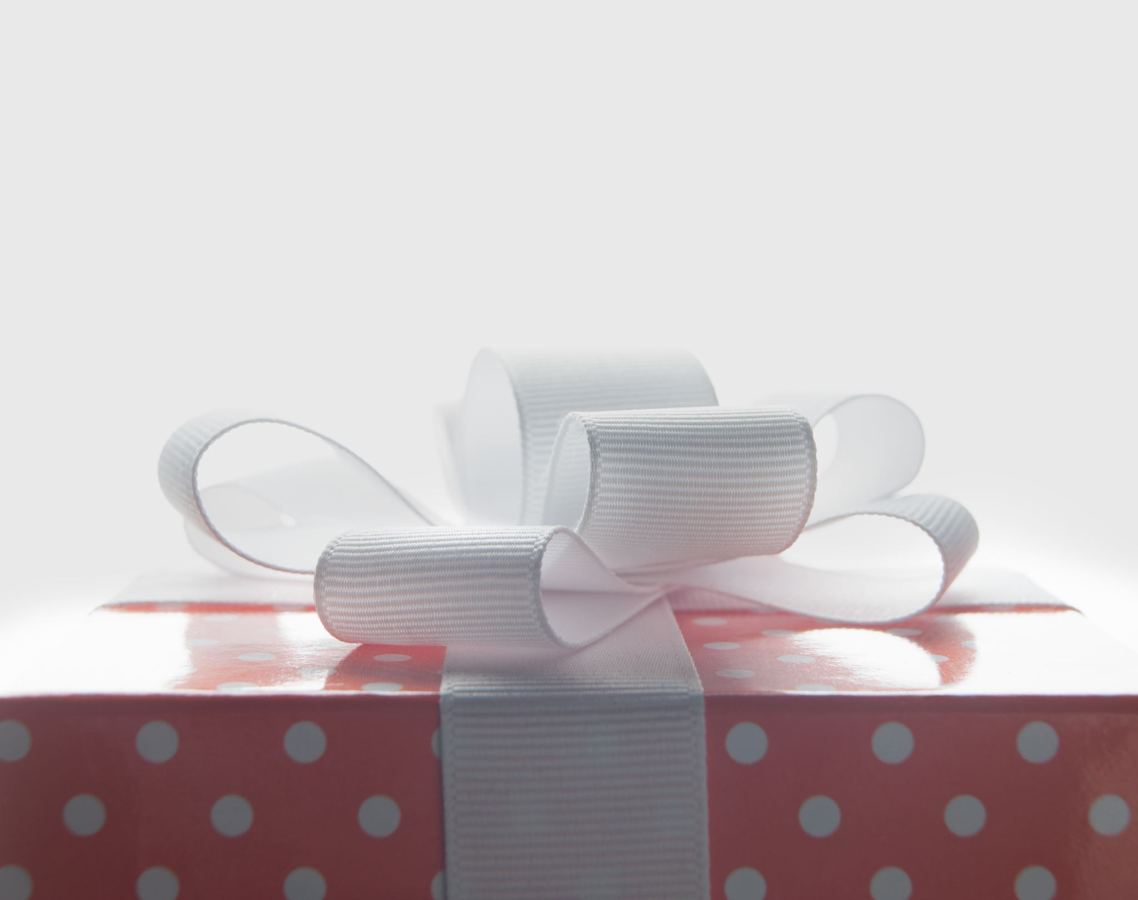
THANK YOU

Slide 15
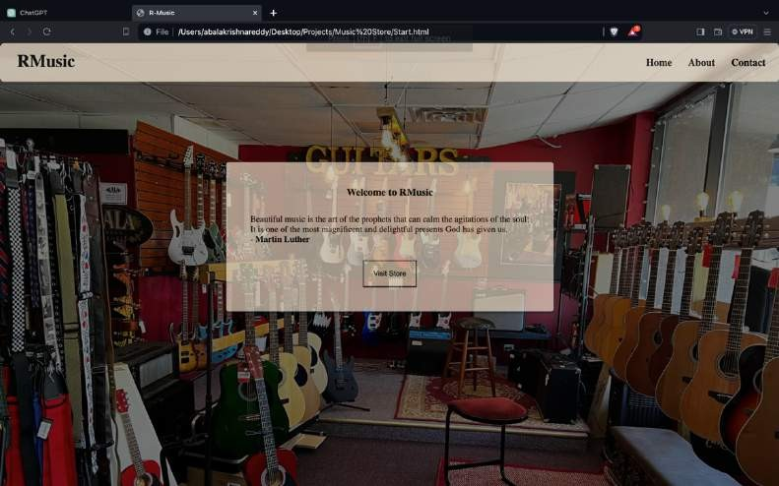
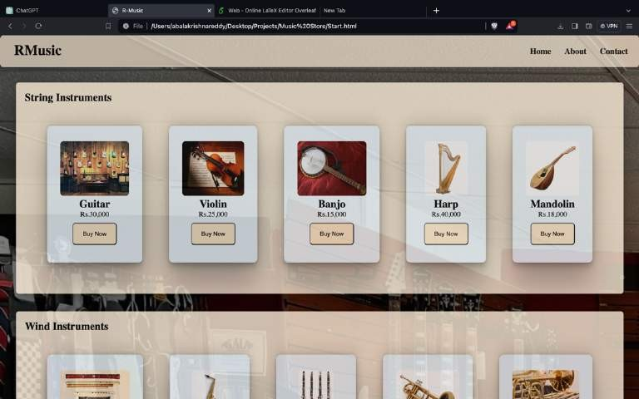
Results
Home Page
Store Page

Slide 16
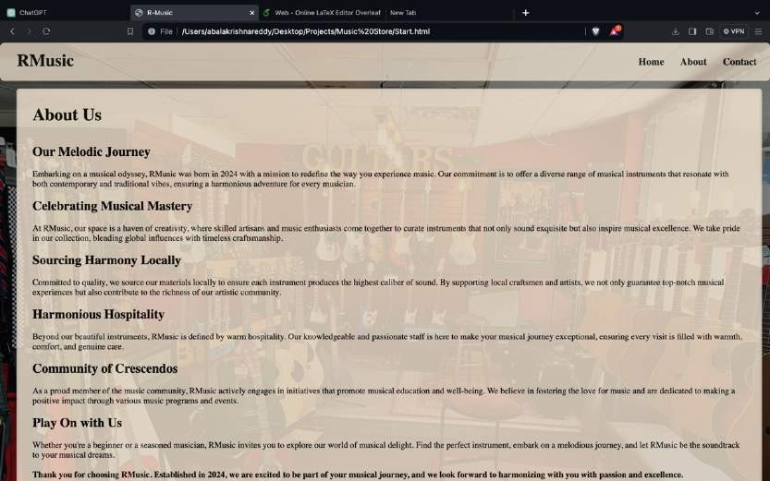
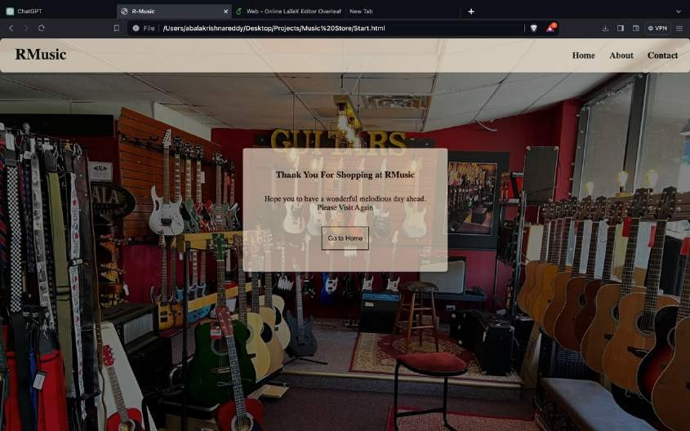
About Us Page
Thanking Page

